Slide 1
Reducing Greenhouse Gas Emissions by Reducing Two-stroke Leaf Blower Use on Campus
By: Dave Roe
Assistant Superintendent
UCSC Grounds Services
April 29, 2015
Notes:
Specific goal

Slide 2
Recently Grounds submitted a project for a Carbon Fund Grant. We were awarded over $14,000 from the Sustainability Office Carbon Fund and Working Group Project Fund. “The Carbon Fund committee strives for a sustainable future by working to mitigate Climate Change through funding and participating in projects to reduce greenhouse gas emissions, conduct relevant research, or carry out education and behavioral change programs.”

Slide 3
The project
The purpose of our project is to provide Grounds Services an opportunity to drastically reduce greenhouse gas emissions using sustainable practices while supporting our mission, “…to provide an economically and efficiently operated, safe and well maintained campus environment.”

Slide 4
Background
Our campus gardeners maintain large areas of landscaping which contain many thousands of square feet of walks and patios that need to be kept safe and clean. We primarily use two stroke gas/oil mix leaf blowers along with raking and sweeping to accomplish this.

Slide 5
2 stroke blowers
Two stroke blowers are very efficient tools and help reduce personnel injuries (mainly repetitive stress from raking and sweeping large areas). A problem with two-stroke leaf blowers is the amount of greenhouse gasses and other pollutants they produce.

Slide 6
How can we reduce pollution and still do our jobs effectively?

Slide 7
The majority of our routine leaf blowing can be done with battery powered leaf blowers.
How much pollution can be reduced ?
Do they have enough blowing power?
Can the batteries last long enough to get the job done?

Slide 8
Edmunds.com performed a study,
“Emissions Test: Car vs. Truck vs. Leaf Blower”
http://www.edmunds.com/car-reviews/features/emissions-test-car-vs-truck-vs-leaf-blower.html

Slide 9
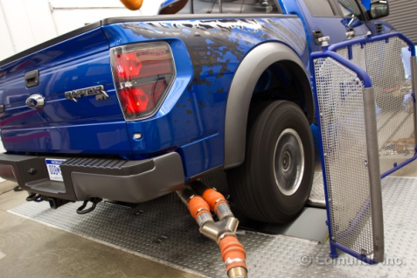
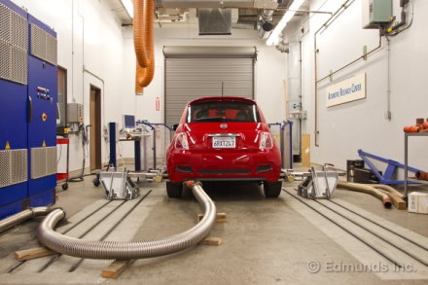
The Test
Compare exhaust emissions on different gasoline powered engines.
2011 Ford Raptor Crew Cab - 411-horsepower 6.2-liter V8, weighs more than 6,200 pounds and has the aerodynamics of Mount Rushmore.
2012 Fiat 500 - The dollop-size Fiat weighs a mere 2,350 pounds and has a 1.4-liter four that generates less than one-fourth the amount of power as the Raptor.

Slide 10
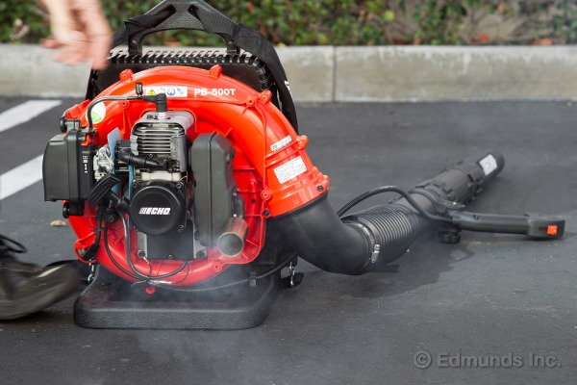
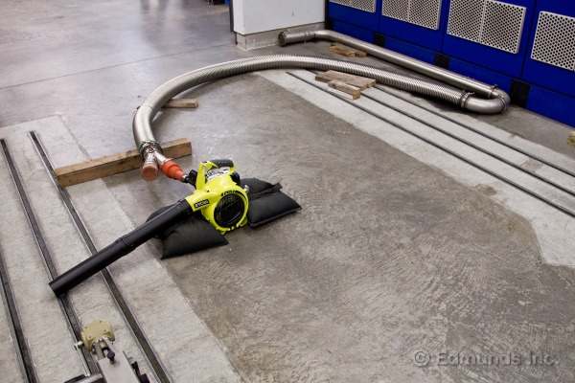
Comparing emissions (cont’d)
The two-stroke leaf blower in this test is an Echo PB-500T, a model that sits in the middle of the manufacturer's range of backpack-style offerings. It's powered by a 50.8cc two-stroke air-cooled single-cylinder engine.
The Ryobi handheld is a RY09440 model that brings a 30cc four-stroke engine.

Slide 11
How they tested the equipment
The FTP 75 test simulates 11.04 miles driven over 31.2 minutes and includes idle periods, accelerations, decelerations and cruising. This driving cycle works great when testing things that boast driven wheels: less so for leaf blowers which, of course, don't. The test we crafted for the leaf blowers followed the FTP 75's duration and speed-up/slow-down pattern with a twist — we substituted vehicle speed with leaf blower speed. We gave the blowers full speed during the cruise periods defined by the FTP 75. The idle periods remained idle periods and boom, there's our leaf blower emissions test.

Slide 12
Results
The three compounds we will focus on are those with which EPA and CARB are primarily concerned, namely, non-methane hydrocarbons (NMHC), oxides of nitrogen (NOx) and carbon monoxide (CO).

Slide 13
The Results
Here, then, are pollutants measured during our testing
expressed in weighted grams per minute:
 | NMHC | NOx | CO
2011 Ford Raptor | 0.005 | 0.005 | 0.276
2012 Fiat 500 | 0.016 | 0.010 | 0.192
Ryobi 4-stroke leaf blower | 0.182 | 0.031 | 3.714
Echo 2-stroke leaf blower | 1.495 | 0.010 | 6.445

Slide 14
The Results

Slide 15
“The two-stroke leaf blower was worse, generating 23 times the CO and nearly 300 times more NMHC than the crew cab pickup. Let's put that in perspective. To equal the hydrocarbon emissions of about a half-hour of yard work with this two-stroke leaf blower, you'd have to drive a Raptor for 3,887 miles, or the distance from Northern Texas to Anchorage, Alaska.”

Slide 16
Options to reduce pollutants
Blow the hardscape with a Ford Raptor
Use a less polluting blower. Lithium-ion battery powered leaf blowers perform nearly the same as our standard Echo PB 265L gas blower.

Slide 17
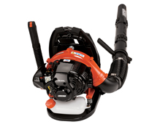
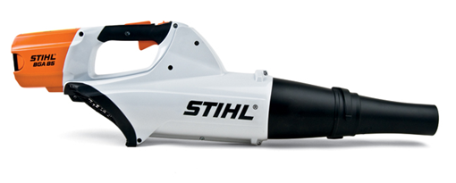
Comparing our most common blower PB265L to the battery powered Stihl BGA85
 | BGA 85 | PB 265L
Air Velocity | 102 mph | Avg - 131 mph, Max - 158 mph
Air Volume | 385 cu ft/min | 375 cu ft/min
Noise Level | 64 dB(A) | 64 dB(A)

Slide 18
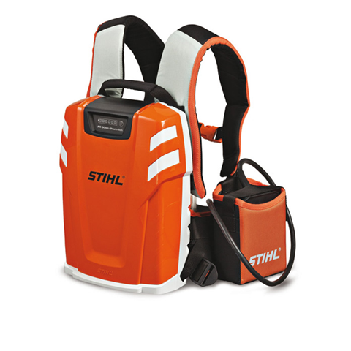
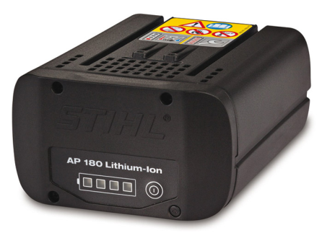
Battery options – which batteries to use?
Backpack battery + backup battery
Two smaller batteries w/ hip belt

Slide 19
Comparing blower & battery weight options to the Stihl handheld BG86 (10.4lbs w fuel, 9.7lbs empty)
Blower & Backpack battery
Blower weight= 7.0 lbs. + backpack battery=15.7lbs.
OR
Blower w/ AP180 battery on blower: 10.8 lbs.
OR
Blower & Hip Belt w 2 batteries
Blower weight = 7 lbs.
Hip belt + 2 batteries = 8 lbs.

Slide 20
Backpack Batteries
Backpack Battery AR900
AP-180 Lithium-ion Battery
Weight: 15.7 lbs.
Blower run time on fully charged battery: 110 min.
Charge time:
80%: 100 minutes
100%: 130 minutes
Weight: 3.8 lbs.
Blower run time on fully charged battery: 23 min.
Charge time:
80%: 20 min.
100%: 28min.

Slide 21
Tracking emission reductions
We are tracking blower use – both battery powered and 2-stroke on our PM checklists by hours used.
The data we get will show us gas blower use, electric blower use, and total blower use (in hours.)
The emissions can then be calculated based on hours of blower use.
By using your data from the PM checklists we can track the emissions reductions monthly or annually.

